Slide 1
CS3210 Lab 5
More MPI
Slides inspired by Sriram's
with demo code provided

Slide 2
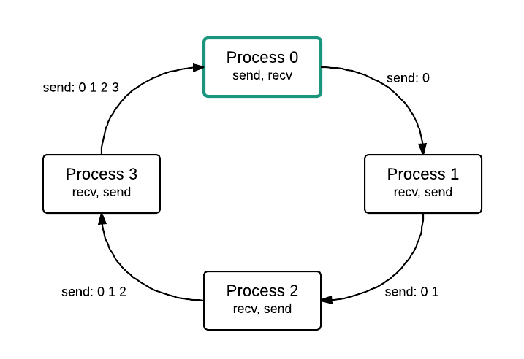
Previously…
Point-to-point MPI Communication
But this is low-level (and tedious to implement for larger programs!)

Slide 3
Lab 5 Concepts
MPI Barriers
MPI Collective Data Movement (Distribution) Operations
Bcast, gather, scatter, alltoall etc.
MPI collective computation
Reduce, allreduce etc.
Communication groups
Virtual Cartesian Topologies

Slide 4
Collective Data Movement & Computation

Slide 5
What is Collective Communication?
Involves all processes in the scope of a communicator
A few types (non-exhaustive)
Synchronisation communication
Data movement operations
Collective computation (data movement with reduction)

Slide 6
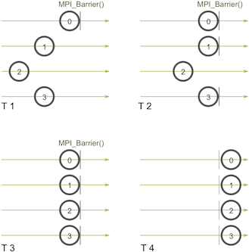
Explicit Synchronization
Blocking: MPI_Barrier(MPI_Comm Comm)
Remember: all processes in the communicator have to call this function!
Non-blocking: MPI_IBarrier(MPI_Comm comm, MPI_Request *request)
Enforces barrier semantics at completion call: MPI_Test or MPI_Wait

Slide 7
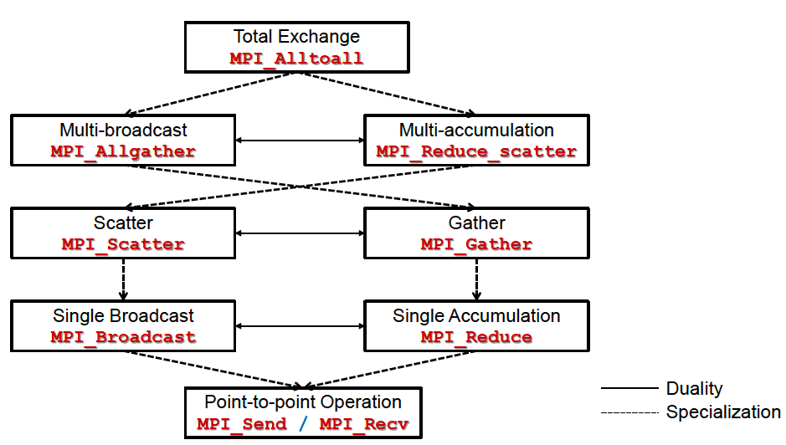
(2) and (3) Data Movement and Computation

Slide 8
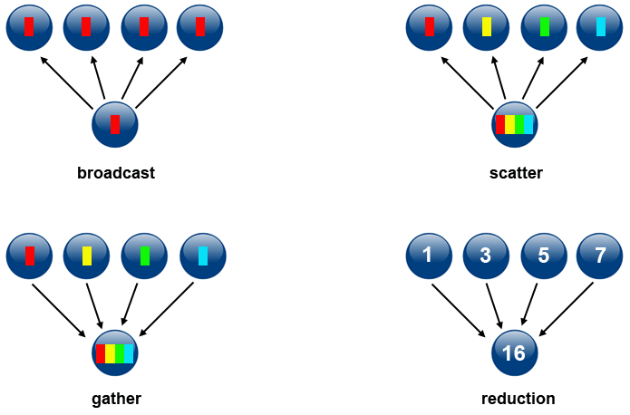
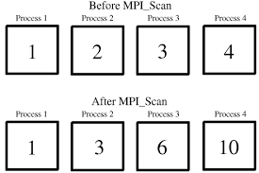
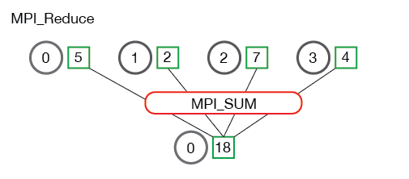
Lots of possible patterns!

Slide 9
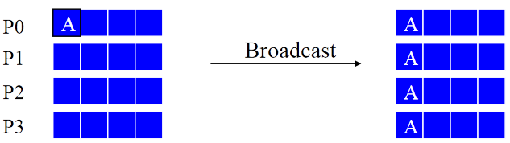
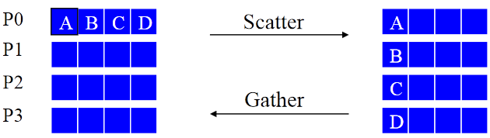
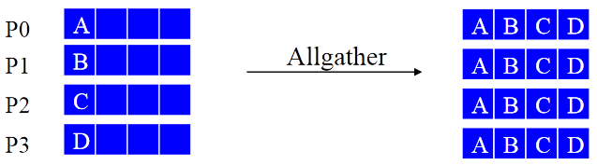
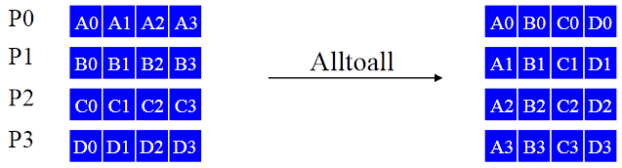
Collective Data Movement
Very useful to reduce the amount of code written!
Again, all the processes must call the same function for these to work.

Slide 10
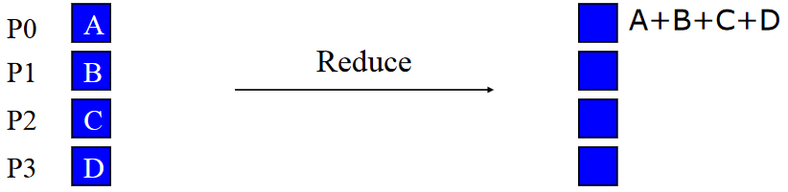
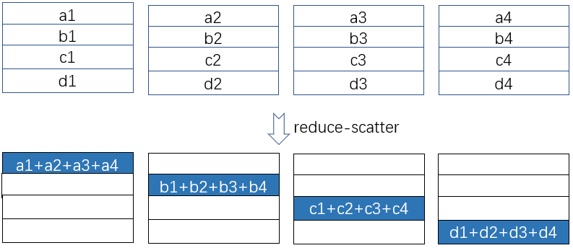
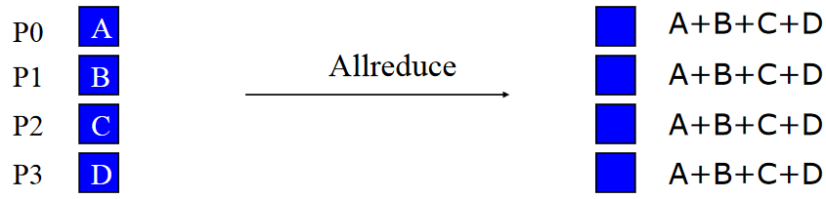
Collective Computation

Slide 11
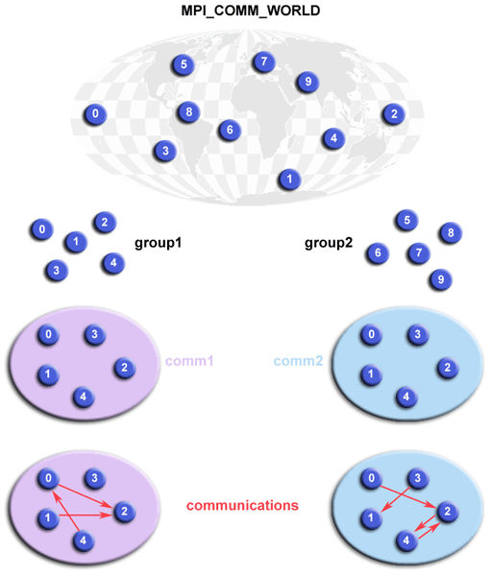
So what are communicators?
A intra-communicator is an object that an MPI_Group (of processes) uses to communicate amongst themselves
MPI_COMM_WORLD is the one for all processes
We can create new groups and associated communicators
Only those processes will participate in communication!
We can also communicate across groups (inter-communicators)

Slide 12
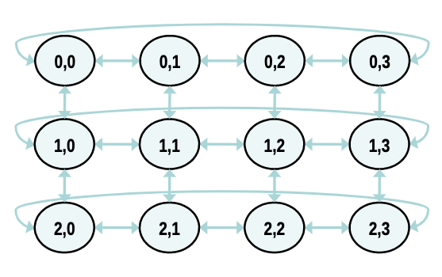
Organizing groups logically: Cartesian
You can ask MPI for help in creating a new communicator organized logically in a cartesian coordinate system
One benefit: can easily find out your “neighbors’” rank and talk to them

Slide 13
MPI Virtual Topologies

Slide 14
MPI_Cart_create?
int MPI_Cart_create (
MPI_Comm comm_old,
int ndims,
const int dims[],
const int periods[],
int reorder,
MPI_Comm * comm_cart
)

Slide 15
MPI_Cart_create
int MPI_Cart_create (
MPI_COMM_WORLD, // default communicator
2, // 2D matrix / grid
int[]{ 4, 4 }, // 4 rows, 4 cols
int[] { 0, 0 }, // row-nonperiodic, col-nonperiodic (no wraparounds)
0, // no reordering of ranks
&cartcomm // new communicator
)

Slide 16
MPI_Cart_create - final layout
0
1
2
3
Does this layout seem familiar to you?
*Asgn 1 flashbacks?*
4
5
6
7
8
9
10
11
12
13
14
15

Slide 17
MPI_Cart_shift?
int MPI_Cart_shift (
MPI_Comm comm,
int direction,
int disp,
int * rank_source,
int * rank_dest
)

Slide 18
MPI_Cart_shift?
int MPI_Cart_shift (
cartcomm, // cartesian communicator
1, // shift along the col coord,
2, // shift by 2
&nbrs[UP], // source - represents the rank directly above
&nbrs[DOWN] // dest - represents the rank directly below
)

Slide 19
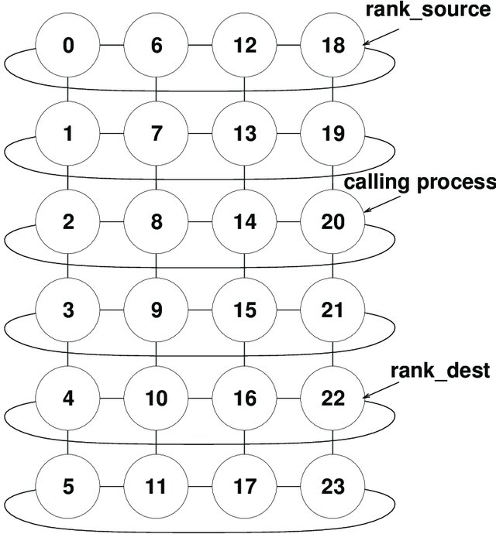
Example #1
Process 20 calls Cart_Shift on col axis with displacement of 2
rank_source will be set = 18
rank_dest will be set = 22

Slide 20
Example #2
int MPI_Cart_shift (
cartcomm, // cartesian communicator
0, // shift along the row coord,
1, // shift by 1
&nbrs[UP], // source - represents the rank directly above
&nbrs[DOWN] // dest - represents the rank directly below
)
int MPI_Cart_shift (
cartcomm, // cartesian communicator
1, // shift along the col coord,
1, // shift by 1
&nbrs[LEFT], // source - represents the rank directly to left
&nbrs[RIGHT] // dest - represents the rank directly to right
)

Slide 21
Example #2
0
1
2
3
4
5
6
7
#define UP 0
#define DOWN 1
#define LEFT 2
#define RIGHT 3
int nbrs[4]?
8
9
10
11
12
13
14
15
{ 1, 9, 4, 6 }

Slide 22
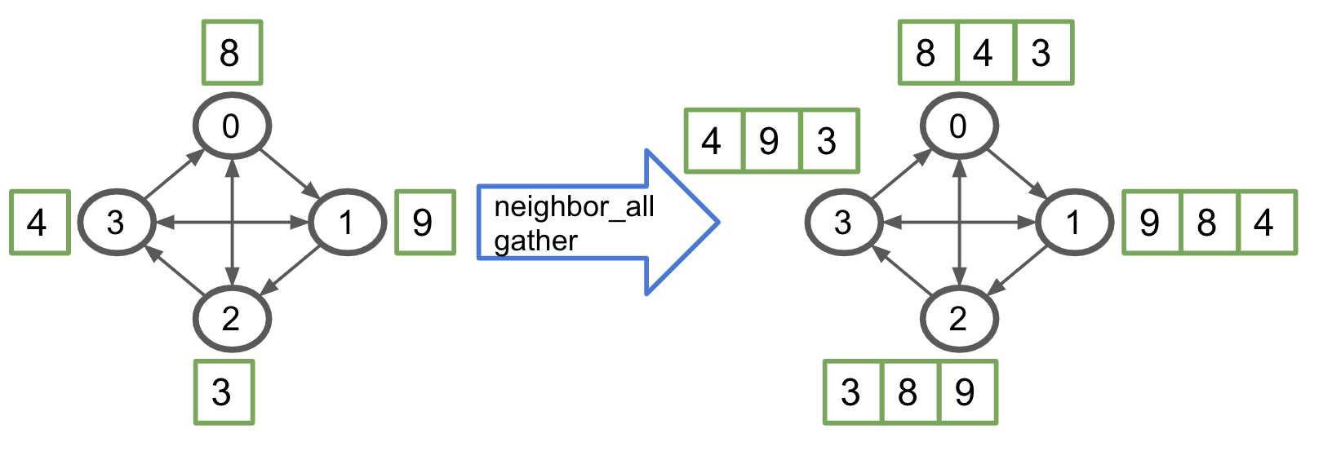
New MPI Neighbour Functions!
neighbor_all_gather → operates on neighbors in topology!

Slide 23
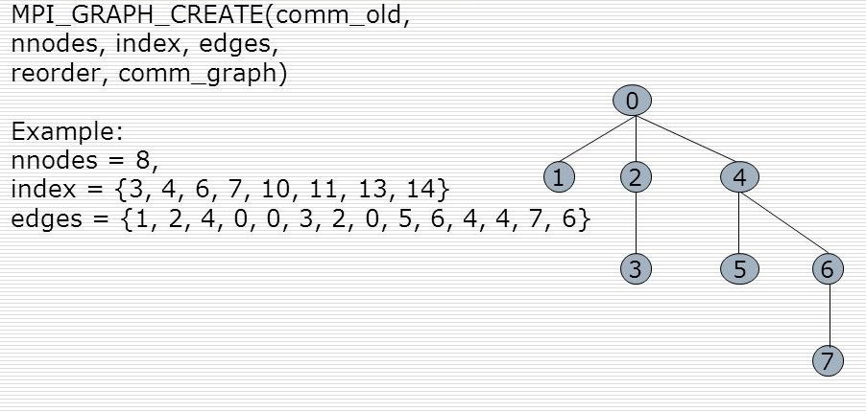
MPI Graph Topology
Even more general than cartesian systems!

Slide 24
More MPI stuff (not covered in Lab sheet but useful for Asgn 3)

Slide 25
Sending Different Datatypes
So far, we’ve been sending MPI built-in types
E.g., MPI_Scatter(...MPI_FLOAT,...);
What if we want to send a struct, for example?

Slide 26
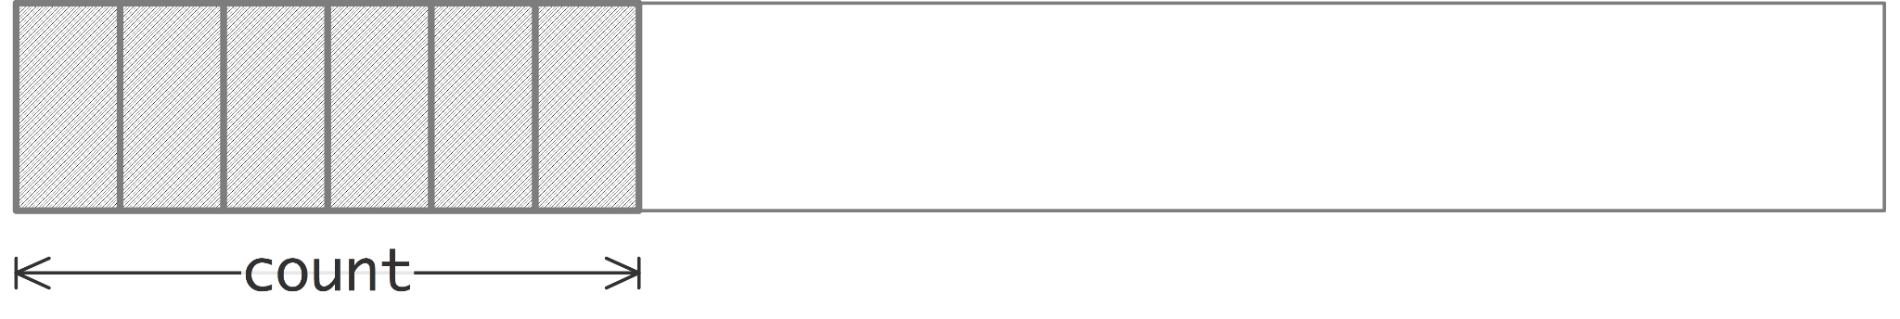
How to send your own datatypes?
MPI needs to know the layout of your data!
Easiest: contiguous section of one MPI type
MPI_Type_contiguous( 6, MPI_CHAR, &my_type );
MPI_Type_commit(&my_type);
Recv and Send with the type my_type into a char buffer of size 6 in this case

Slide 27
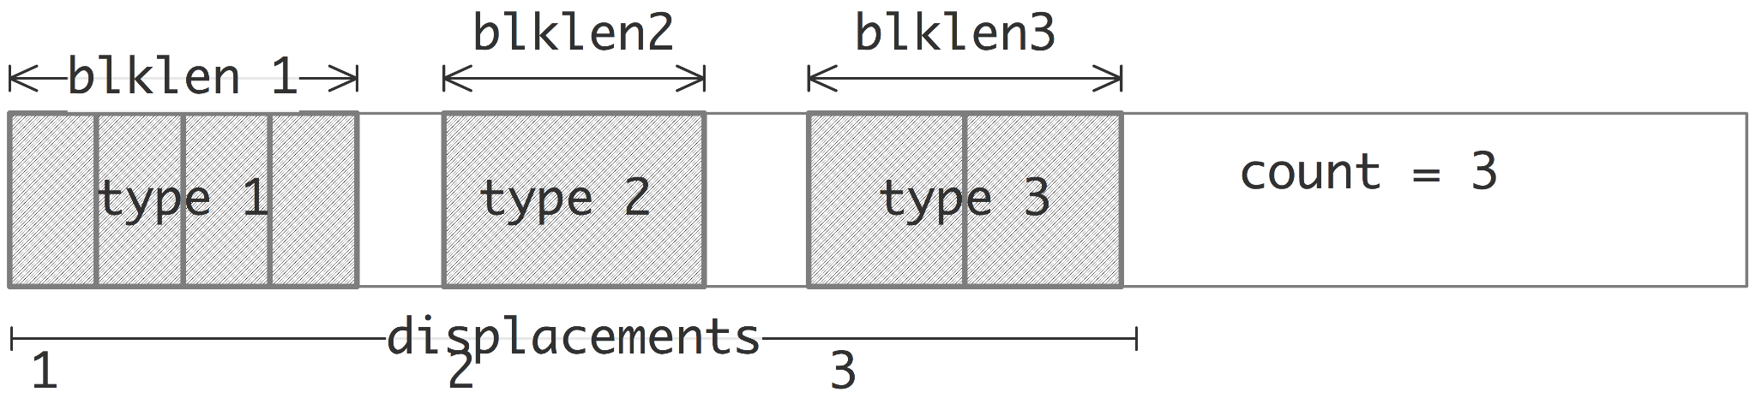
How to send your own datatypes?
Most general: MPI_Type_create_struct
Have to specify how many “blocks” of elements, their types, their offsets, …
Read documentation for more info

Slide 28
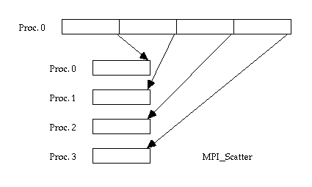
Common issue: unequal #items per process
E.g. MPI_Scatter
Assumption: each process gets same no. of items
But this is often not the case due to uneven division! (e.g. 17 items divided into 4 procs)

Slide 29
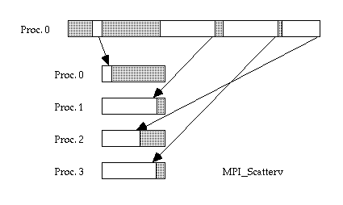
Common issue: unequal #items per process
Solution: e.g. MPI_Scatterv
Don't have to send the same no. of items
Don't have to send contiguously
Can send in any order to the processes!
Full control

Slide 30

End of lab 5
Slides uploaded!
Feedback: bit.ly/feedback-theodore or scan below
Email: theo@comp.nus.edu.sg
Extra stuff on next slide

Slide 31
Things to try (Thanks Zhi Heng)
https://gist.github.com/Polygonalr/9ba2365987182b6caa4cfb9314720aba
Cartesian topology:
vim mpi-cart.cpp
salloc --ntasks 16 mpirun ./mpi-cart
Custom datatype:
vim custom.cpp salloc --nodes 2 --ntasks 3 mpirun ./custom

